Slide 1
Decoupling Workflow From Forms
Using an Application Controller, IoC Container, Event Aggregator, and Command pattern
Presented By:
Derick Bailey
Copyright 2009 McLane Advanced Technologies, LLC

Slide 2
Topics Of This Presentation
Topics Covered
Event Aggregator
Command Pattern
Application Controller
Wiring Together With IoC Container
Topics Not Covered Directly
Model-View-Presenter and Other View Implementation Patterns
Repository and Other Persistence Patterns
Business Logic and Rules Validation Patterns
User Experience Design
Error Handling and Other Real-World Needs
Other Best Practices for Division of UI and Organization of Code

Slide 4

Simple Org Chart
The Sample Application

Slide 5
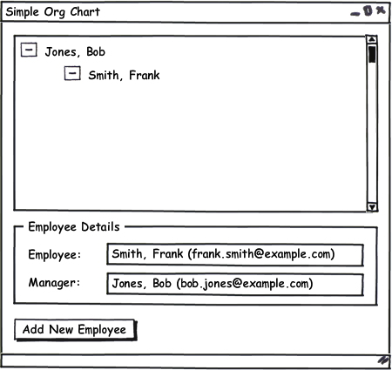

Slide 6
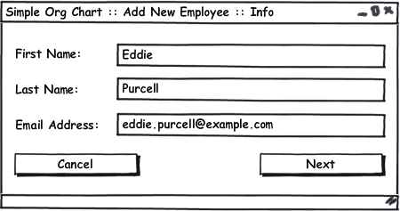
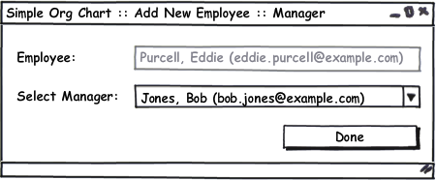

Slide 8
(Section Header)
(section sub title)

Slide 11
(Section Header)
(section sub title)

Slide 14
(Section Header)
(section sub title)

Slide 17
Additional Resources
Command Pattern
http://www.lostechies.com/blogs/derickbailey/archive/2008/11/19/ptom-command-and-conquer-your-ui-coupling-problems.aspx
Event Aggregator http://www.martinfowler.com/eaaDev/EventAggregator.html
IoC Container (StructureMap)
http://structuremap.sourceforge.net
Application Controller
http://www.martinfowler.com/eaaCatalog/applicationController.html

Slide 18
About Me… Derick Bailey
Sr. Software Engineer and Architect @ McLane Advanced Technologies
Blog: derickbailey.lostechies.com
Email: derick.bailey@mclaneat.com derick@derickbailey.com
Twitter: @derickbailey
www.mclaneat.com
McLane Advanced Technologies
4001 Central Pointe Parkway
Temple, Texas 76504
800-988-5428
Copyright 2008 McLane Advanced Technologies, LLC

